Slide 1
What is class? Must we always talk at cross-purposes?
There are many concepts of class – not all attempting to identify or explain the same things. Need not be mutually exclusive.
Set of loosely-related concepts concerning economic inequalities and also, in various ways, other kinds of inequality that are often associated with them e.g. to do with culture, behaviour, identity.
We need to ask what each concept of class is attempting to explain: or ‘if class is the answer, what’s the question?’
Some are merely about differences: social stratification e.g. different levels of income and wealth.
Some are relational – about interdependencies between the classes identified e.g. (in different ways) Marx, Bourdieu

Slide 2
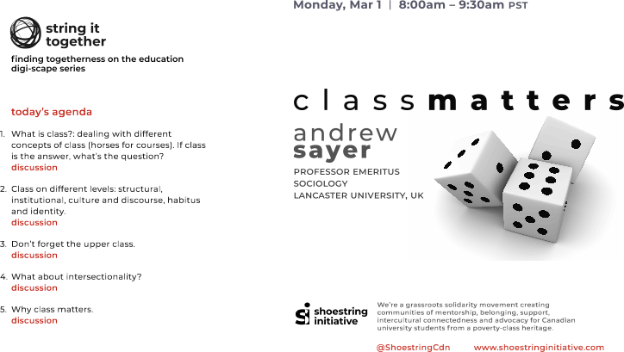

Slide 3
Different levels . . .
Property relations – e.g. Marx – for explaining the basic structure of capitalism: what is most fundamental to its functioning? Not about status, life chances or cultural differences, though there may be some correlation between these and Marxist classes.
The unequal division of labour between jobs with more or less pay and power and authority and status (Weber, Erik Olin Wright).
Beyond economic inequalities . . . Bourdieu: cultural and social capital (e.g. ways of speaking) and how these get embodied, so the individual’s dispositions or habitus reflects their position in society relative to others.
Official concepts of class categorisation – data driven.
Folk or lay concepts of class face the social scientist as both object of study (because they affect behaviour) and as rival explanation of the social order. But analytically they are a mess.
Notes:
Bourdieu – the contestation of definitions of class is part of the class struggle

Slide 4
Another way of looking at levels
Structural e.g. enduring structures of interdependent positions like property relations, division of labour, segregation of types of housing and hence social areas.
Institutional: the reproduction of class inequalities by the norms and practices of institutions (e.g. reproducing unequal pay structures, favouring middle class behaviours).
Recognition and mis-recognition. Embodied in dispositions (including unconscious forms of bias) that produce common types of behaviour, and common forms of classification.
The lived experience.

Slide 5
How much difference would it make if the upper and middle classes were nice, respectful and considerate to the working class?
Don’t forget economic structure!
Distribution and recognition – class is primarily the result of distribution, and only secondarily a matter of recognition.
Identity-sensitive and identity-insensitive mechanisms: Class is primarily a consequence of identity-insensitive mechanism
e.g. retail workers losing their jobs
Break for questions . . .

Slide 6
Intersectionality: class in relation to other sources of inequality
Intersections between two or more sources of inequality – mutually reinforcing or mutually off-setting? An empirical question.
Applies to the advantaged too.
Counterfactual questions:
Can racialized inequalities exist without class differences?
Can class inequalities exist without racialized differences?
Could class inequalities exist without gender inequalities?
May be seamlessly combined at level of behaviour. Beware of assuming that what often goes together must go together.
Covert racialisation of class – equating working class with whites.
Break for questions
Notes:
Gargi Bhattacharyya – author of book on Racial Capitalism – argues race is not essential to capitalism

Slide 7
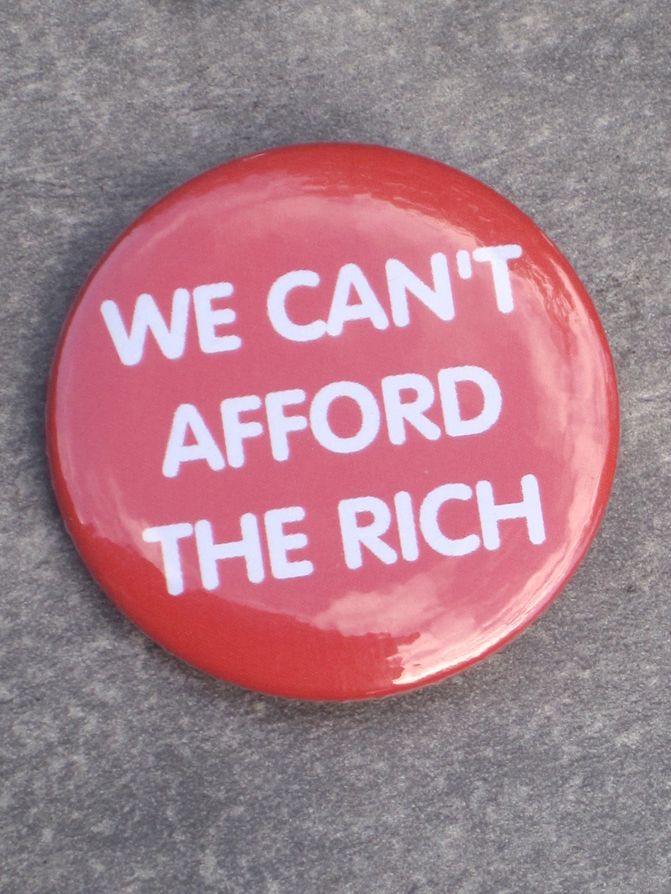
Don’t forget the upper class! – the rich
Small in number, huge in economic and political power.
Happy to be ignored by social science and to call themselves middle class in order to hide in the middle.
Depends on unearned income/wealth ie. Based on control of assets that others need: land, property, means of production, internet platforms . . . Allow them to extract wealth that others produce.
Not only capitalists in the classic sense but ‘rentiers’ – landlords, money-lenders, speculators, monopolists, platform owners

Slide 8
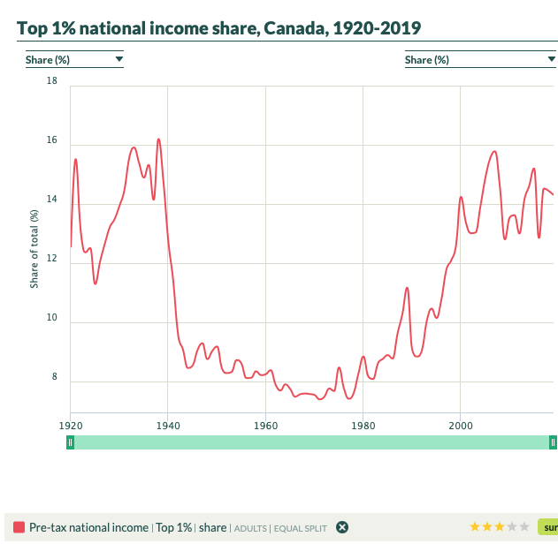

Slide 10
Why class matters
The unjust inequality that capitalism can’t remove. Equal opportunity policies ignore class inequalities.
An old and unfashionable form of inequality.
Outcomes in terms of inequalities of opportunity are unfair – the accident of birth. Objective and subjective effects.
Based on economic relationships that are unfair, exploitative, divisive and repressive – e.g. employment relations, debt relations – and drive climate disaster.
Socialist policies, organized labour needed to reduce class inequalities
Notes:
Inc. health inequalities

Slide 11
Other issues
Social mobility, ‘meritocracy’
Precariat
Housing classes, geography
Pandemic
?
Questions?

